Slide 1

Comprehensive Digital Marketing Project Work

Slide 2
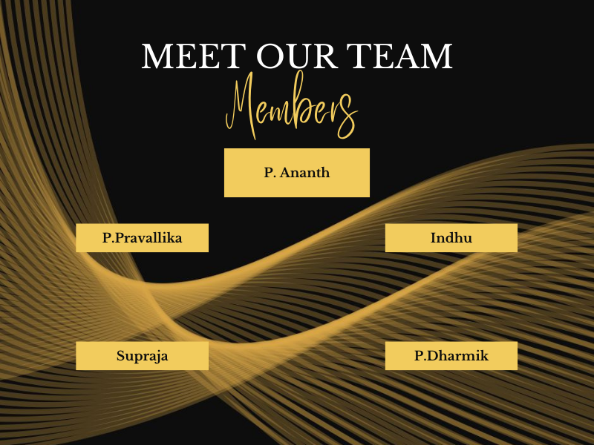

Slide 3

Part 1: Brand study, Competitor Analysis & Buyer’s/Audience’s Persona
COMPANY/TOPIC for project : BALIJI TELEFILMS
Research Brand Identity: Study the brand's mission, values, vision, and unique selling propositions (USPs).
Genre: Entertainment
Logo :
Mission/Values:
We endeavor to maintain a healthy pipeline for new TV shows and strive to consistently deliver top-quality content catering to a diversified audience across genres in India.

Slide 4

USP : USP FOR ALTBALAJI. Unique content. ALT Balaji is captivating customers through its original and diverse content. Tagline: "Entertainment Unleashed"
Subsidiaries: ALLT, Balaji Motion Picture, More
Trade as : BSE: 532382 NSE: BALAJI TELE

Slide 5
Part 1: Brand study, Competitor Analysis &Buyer’s/Audience’s Persona
Analyze Brand Messaging : Analyzing the brand messaging for Balaji Telefilms involves a comprehensive examination of various aspects of their communication, marketing strategies, content offerings, and audience engagement.
Examine the brand’s tagline :
As of my last update in September 2021, Balaji Telefilms did not have a specific tagline that was consistently used across all its communication channels. Instead, the company often relied on the use of its logo and brand name as its primary means of identification.
However, it's worth noting that brands may update their taglines or slogans periodically to reflect evolving brand strategies or marketing campaigns. Therefore, to get the most accurate information on Balaji Telefilms' current tagline or any recent changes, I recommend visiting their official website or checking their latest marketing materials and communications.

Slide 6
Part 1: Brand study, Competitor Analysis & Buyer’s/Audience’s Persona
Competitor Analysis: Select three competitors operating in the same industry or niche as the chosen brand, examine their USPs and online communication
As of my last update in September 2021, Balaji Telefilms is a prominent Indian media and entertainment company known for its television content production, films, and digital streaming services. To examine its competitors in the Indian media and entertainment industry, I'll consider the major players operating in the same niche.
Balaji Telefilms faced competition from several other media production companies in the Indian entertainment industry. Keep in mind that the competitive landscape might have evolved since then, so it's essential to conduct a fresh analysis for the most up-to-date information. Nevertheless, here are three key competitors that Balaji Telefilms might have faced:

Slide 7
Competitor 1:https://www.zee.com
Zee Entertainment Enterprises Limited:
USP: Zee is one of India's largest media and entertainment conglomerates, known for its diverse portfolio of television channels across multiple languages and genres. Their USP may revolve around providing a wide array of content options catering to various audience segments.
Communication: Zee Entertainment leverages its official website, social media channels, and ZEE5 (their digital streaming platform) to promote their shows, movies, and special events. They may use engaging content, trailers, and teasers to create buzz around their offerings and interact with their audience through interactive campaigns
Competitor 2: https://www.disneystar.com
Star India (A subsidiary of The Walt Disney Company):
USP: Star India is a leading media conglomerate in India with a vast network of television channels and a popular digital platform, Disney+ Hotstar. Their USP may include a blend of premium content, exclusive sports rights (such as IPL cricket), and access to a vast library of Disney content.

Slide 8
Communication: Star India's online communication strategy focuses on leveraging its website, social media presence, and Disney+ Hotstar platform to engage with viewers. They might utilize live streaming of events, social media contests, and exclusive sneak peeks to generate excitement and drive subscriptions.
Competitor 3: https://www.sonypicturesnetworks.com/&ved
Sony Pictures Networks India:
USP: Sony Pictures Networks India is a major player in the Indian television industry, offering a mix of sports, entertainment, and movie channels. Their USP may lie in their strong sports portfolio, high-quality production values for shows and movies, and a diverse range of content genres.
Communication: Online Communication: Sony Pictures Networks India likely uses its website, social media platforms, and Sony LIV (their digital platform) to interact with their audience. They might employ innovative marketing campaigns, behind-the-scenes content, and interactive polls to keep their viewers engaged.
For the most current information on Balaji Telefilms and its competitors' USPs and online communication strategies, I recommend conducting up-to-date market research and visiting the official websites and social media accounts of each company. This will help you gain valuable insights into their latest offerings and promotional approaches in the rapidly evolving entertainment industry.

Slide 9
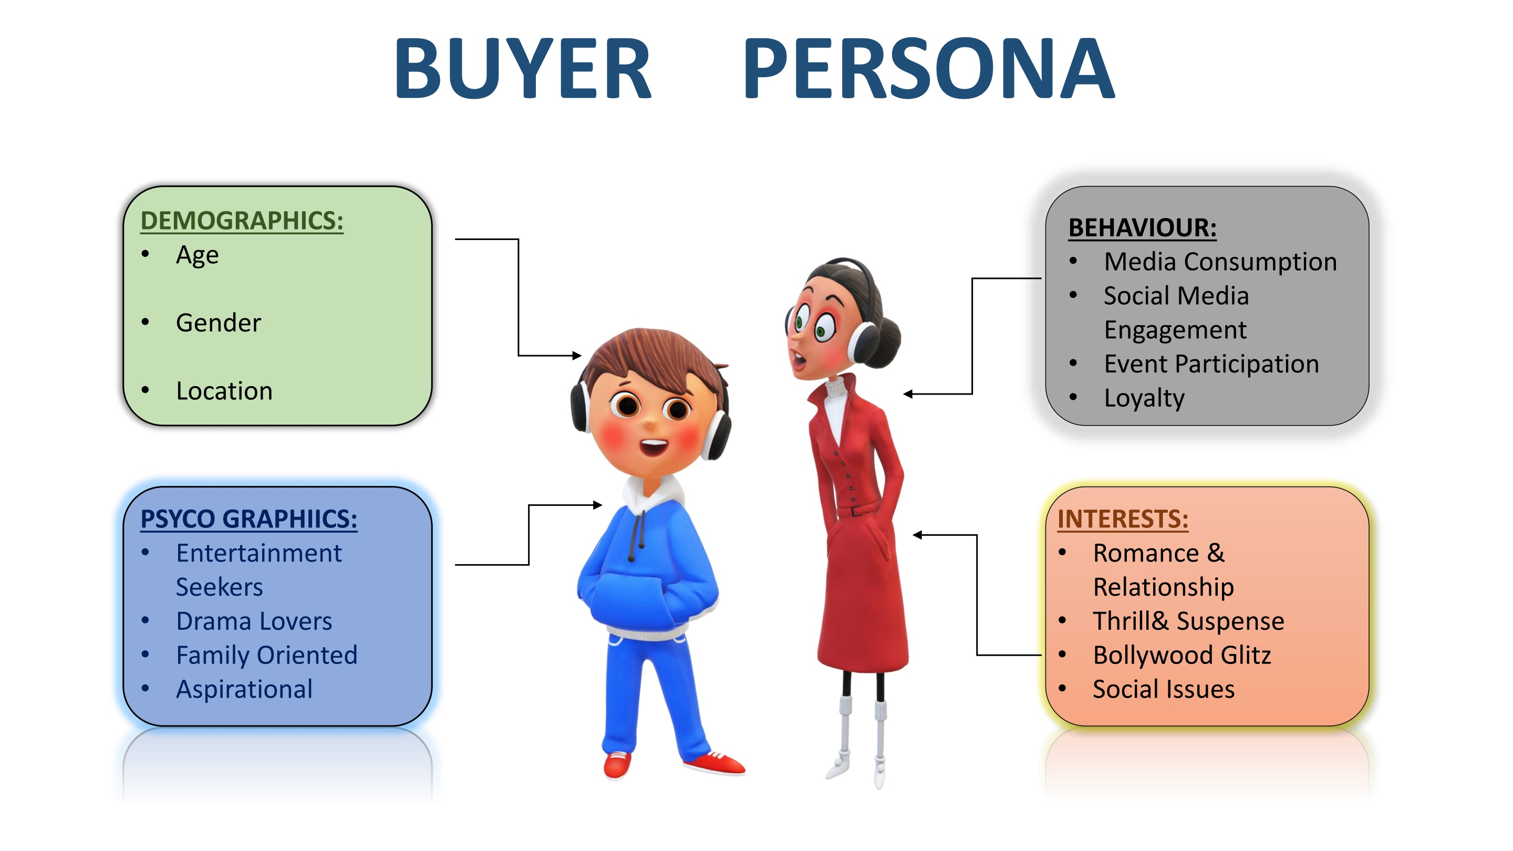
Part 1: Brand study, Competitor Analysis & Buyer’s/Audience’s Persona
Buyer's/Audience's Persona: Clearly define the target audience for the chosen brand. Consider demographics, psychographics, behaviors, and interests.
Balaji Telefilms is an Indian television and film production company known for its diverse array of entertainment content. To clearly define the target audience for Balaji Telefilms, we should consider several factors, including demographics, psychographics, behaviors, and interests. Keep in mind that the information below is based on the knowledge available up to September 2021, and there might have been some changes in their content strategy and audience targeting after that.

Slide 10
Demographics:
Age: Primarily targeted at the 15-45 age group, with a focus on young adults and middle-aged individuals.
Gender: Balanced appeal to both male and female audiences, with specific content catering to each.
Location: Mainly urban and semi-urban areas across India, with some international viewership, especially in countries with a significant Indian diaspora.
Psychographics:
Entertainment Seekers: People who actively seek entertainment through various media channels, including television and digital platforms.
Drama Lovers: Those who enjoy melodramatic storytelling, emotional narratives, and gripping plots.
Family-Oriented: Content that resonates with family values and relationships, making it suitable for family viewing.
Aspirational: Viewers who are inspired by success stories and personal growth arcs portrayed in the content.

Slide 11
`
Behaviors:
Media Consumption: Regular viewers of television shows, web series, and movies across various platforms.
Social Media Engagement: Actively engaged on social media platforms, discussing and sharing opinions about Balaji Telefilms' content.
Event Participation: Attend events, promotions, and fan interactions related to Balaji Telefilms' shows and movies
Loyalty: A significant portion of the audience may have a long-standing loyalty to Balaji Telefilms due to its history of successful productions
Interests:
Romance and Relationships: Content featuring love stories, family dynamics, and interpersonal relationships.
Thrill and Suspense: Shows and movies with gripping storylines, mysteries, and plot twists.
Bollywood Glitz: Glamorous settings, stylish fashion, and star-studded casts often associated with Bollywood productions.
Social Issues: Dramas that touch upon relevant societal issues, encouraging awareness and discussions.
It's important to note that over time, the target audience and content strategy of Balaji Telefilms may evolve to adapt to changing market trends and viewer preferences. Therefore, for the most accurate and up-to-date information, it would be best to refer to more recent sources and market research data

Slide 12
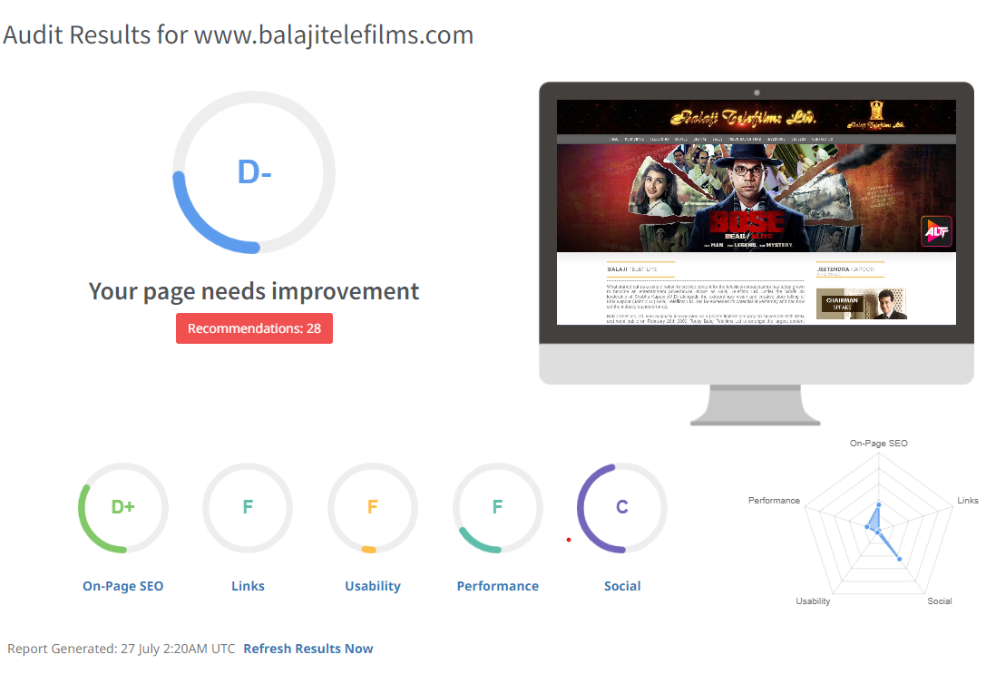
Part 2: SEO & Keyword Research
SEO Audit: Do an SEO audit of the brands website
SEO factors to consider when conducting an SEO audit for their website. You can use this checklist to evaluate the website's overall SEO health
Check Website Structure and
Navigation:
Ensure the website has a clear
and user-friendly structure with a
Logical hierarchy of pages and a
Consistent navigation menu.
Verify that essential pages like
(Home, About, Contact, etc.)
Are easily accessible.

Slide 13
On-Page SEO:
Check if the website's pages have unique and descriptive title tags, including relevant keywords.
Ensure meta descriptions are well-crafted, compelling, and encourage click-throughs from search engine results pages (SERPs).
Analyze the content for keyword optimization, natural language use, and relevance to the target audience.
Technical SEO:
Check for any crawl errors using tools like Google Search Console to identify broken links or pages that are not being indexed properly.
Verify that XML sitemaps and robots.txt files are correctly set up to guide search engine crawlers.
Ensure the website is mobile-friendly and responsive across various devices.

Slide 14
Keyword Analysis:
Review the website's content and meta tags to identify the target keywords being used.
Assess the relevance and search volume of these keywords to the content and the overall business goals.
Page Speed and Performance:
Evaluate the website's loading speed using tools like Google Page Speed Insights or GTmetrix.
Compress images and leverage browser caching to improve load times.
Backlink Analysis:
Review the website's backlink profile to identify the quality and quantity of inbound links.
Disavow any spammy or irrelevant links that might be harming the website's rankings.

Slide 15
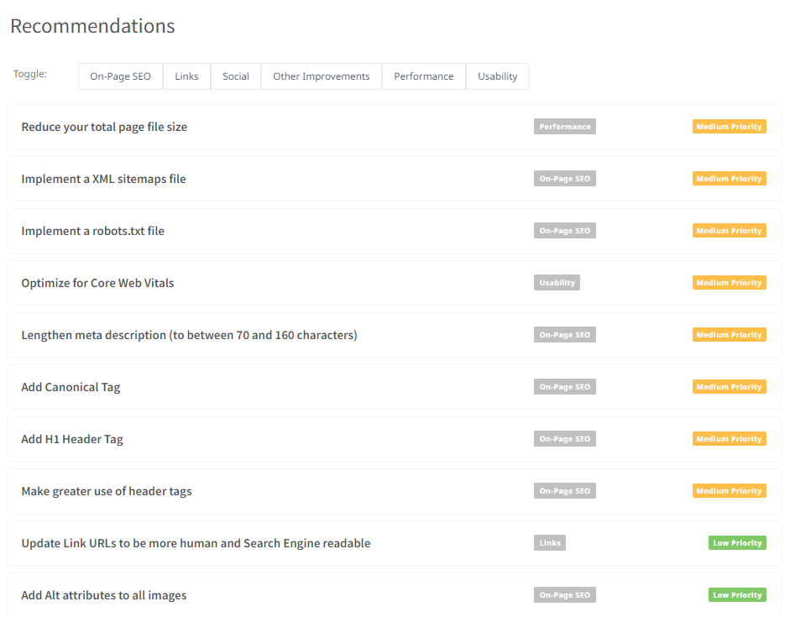
Social Media Integration:
Check if the website is
integrated with relevant
Social media profiles
Ensure that social media
sharing buttons are present
on content pages.

Slide 16
Local SEO (if applicable):
If Balaji Telefilms has physical locations or targets specific regions, verify the accuracy and consistency of NAP (Name, Address, Phone) information across local directories.
Content Marketing and Blog:
Evaluate the website's blog and content marketing efforts.
Assess the quality, relevance, and engagement of the blog posts.
Analytics and Tracking:
Ensure that the website has Google Analytics or any other preferred web analytics tool set up to monitor website traffic and user behavior.
Remember that an SEO audit is an ongoing process, and regular checks and optimizations are necessary to maintain and improve search engine rankings. If you're not confident in conducting a comprehensive audit yourself, consider seeking help from an experienced SEO professional or agency.

Slide 17
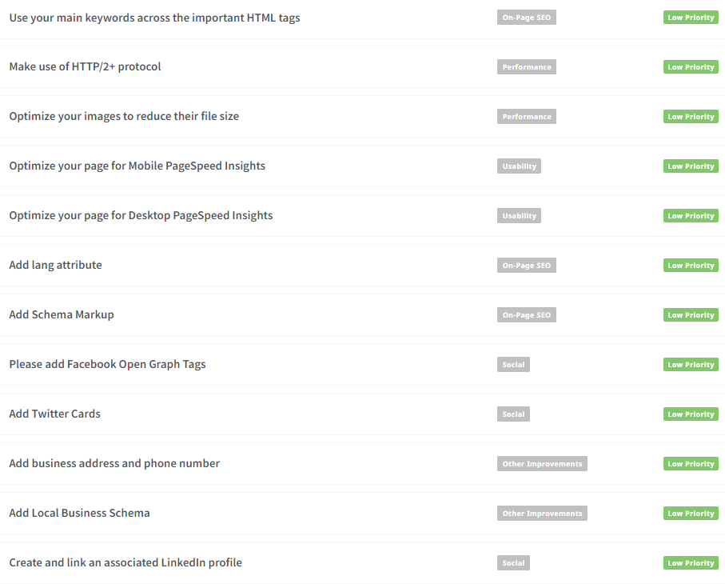
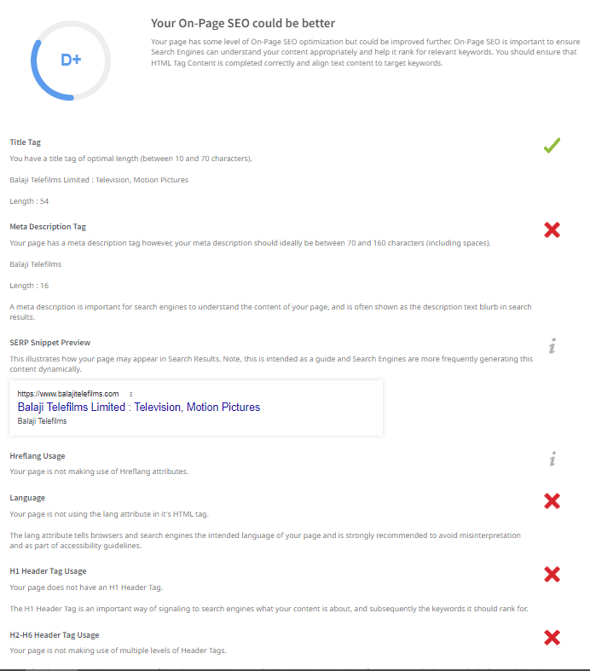

Slide 18
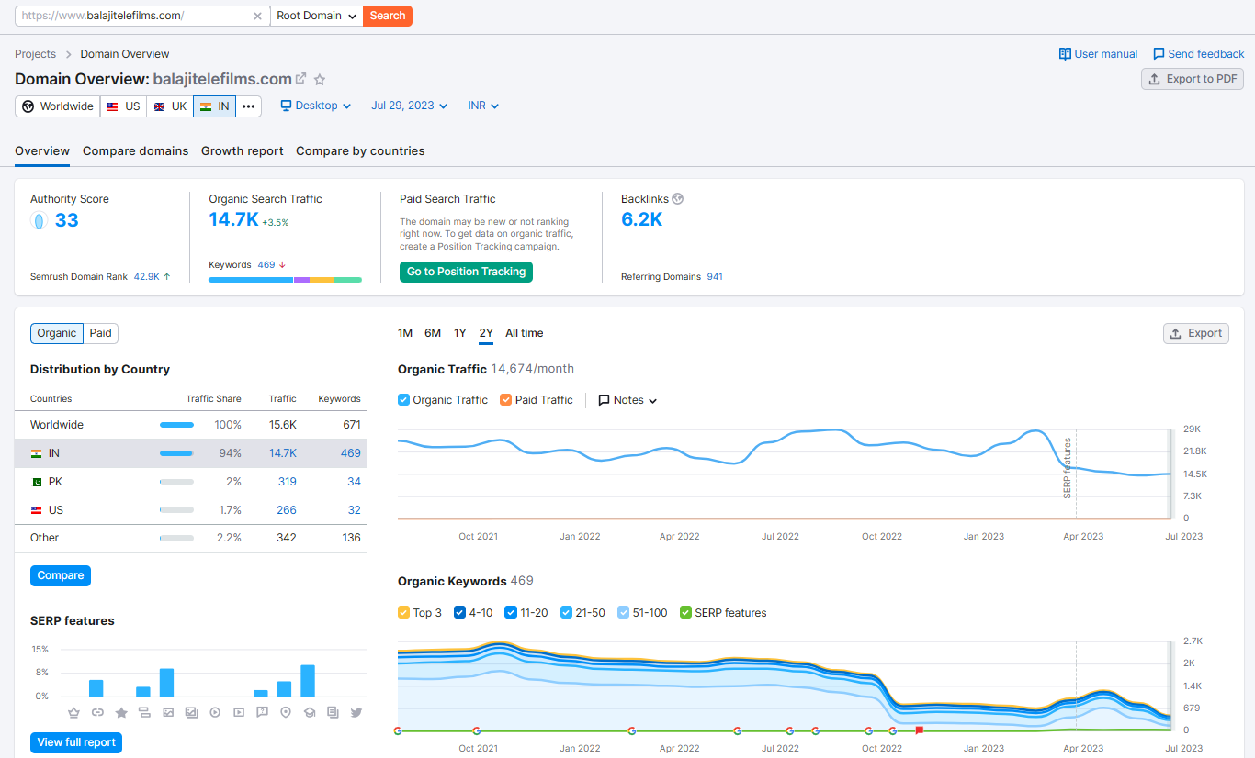
Keyword Research:
Keyword research is a crucial process in digital marketing and SEO (Search Engine Optimization). It involves identifying and analyzing relevant keywords that align with a business's objectives and target audience. For Balaji Telefilms, a media and entertainment company, the following steps can be taken to conduct keyword research:

Slide 19
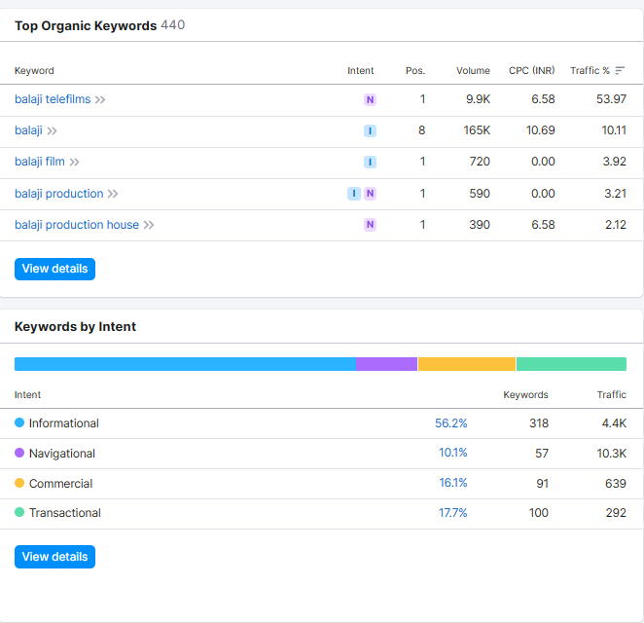
Define Research Objectives: Start by clearly defining the research objectives. In this case, Balaji Telefilms may want to increase website traffic, improve online visibility, and boost conversions for its media content. Understanding the specific goals will help in finding the right keywords to target.
Brainstorm Seed Keywords: Brainstorm a list of seed keywords that are directly related to Balaji Telefilms' offerings and services. Seed keywords are the foundation of the research and act as starting points for further exploration. Examples of seed keywords could be "Indian TV shows," "Hindi web series," "Bollywood entertainment," etc.
Utilize Keyword Research Tools: Leverage keyword research tools like SEMrush or Moz Keyword Explorer to expand the seed keyword list and gain insights into search volume, competition, and potential traffic. These tools provide valuable data on keyword variations and related terms.
Analyze Competitor Keywords: Identify competitors in the media and entertainment industry and analyze their keyword strategies. Look for keywords that they are targeting successfully and consider incorporating them into Balaji Telefilms' own strategy. Tools like SEMrush or Moz can help uncover competitor keywords.

Slide 20
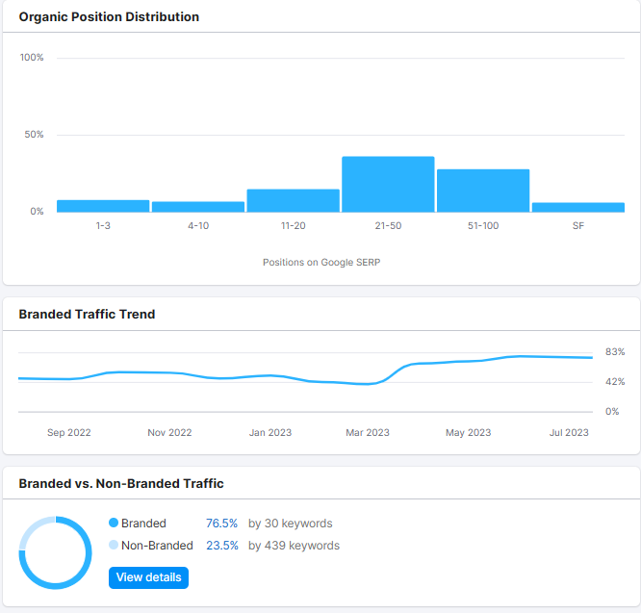
Long-tail Keyword Exploration: Long-tail keywords are more specific, longer phrases that usually have lower search volume but higher conversion potential. They often indicate more focused intent from users. For Balaji Telefilms, focus on long-tail keywords related to their popular TV shows, web series, and movies. Examples include "best Indian TV shows with strong female leads," "Bollywood web series for youth," etc.
Assess Competition and Conversion Potential: While targeting long-tail keywords, consider their competition level and conversion potential. Choose keywords that have a reasonable search volume, moderate competition, and indicate user intent aligned with Balaji Telefilms' offerings. These keywords are more likely to bring in relevant traffic and higher conversion rates.
Optimize Website Content: Once the target keywords are identified, optimize the website's content to include these keywords naturally. Create high-quality, engaging content that addresses the user's intent and provides value. This approach can improve search engine rankings and attract more qualified visitors.

Slide 21
On page Optimization: Meta Tag optimization & content optimization
Meta Tag Optimization:
Title Tag: The title tag is the most important meta tag. Ensure each page has a unique and descriptive title (around 50-60 characters) that includes relevant keywords and clearly reflects the content of the page. For example: "Popular Indian TV Shows | Balaji Telefilms."
Meta Description: Write compelling meta descriptions (around 150-160 characters) for each page. The description should accurately summarize the content and include relevant keywords to encourage users to click on the link. For example: "Explore the best Indian TV shows and web series produced by Balaji Telefilms, a leading media and entertainment company."
URL Structure: Create user-friendly and descriptive URLs for each page. Include relevant keywords in the URL to make it more search engine friendly. For example: "www.balajitelefilms.com/bollywood-web-series."
Header Tags (H1, H2, H3, etc.): Use header tags to structure the content hierarchy. The H1 tag should contain the main target keyword and reflect the page's topic. Subheadings (H2, H3, etc.) should be used to organize content under different sections.

Slide 22
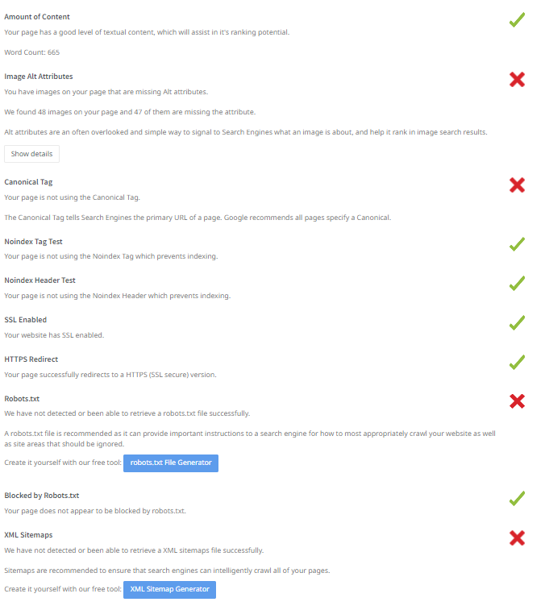
Content Optimization:
Keyword Research: Conduct thorough keyword research to identify relevant keywords for each page. Use tools like SEMrush or Moz Keyword Explorer to find keywords with good search volume and low competition that align with Balaji Telefilms' offerings.
Quality and Unique Content: Create high-quality, unique, and engaging content that adds value to the audience. Avoid duplicate content as it can negatively impact SEO rankings.
Keyword Placement: Incorporate the chosen target keywords naturally throughout the content. Avoid keyword stuffing, as it can lead to penalties from search engines. Aim for a keyword density of around 1-2%.
Use of Multimedia: Enhance the content with relevant images, videos, and infographics. Multimedia can make the content more engaging and shareable.
Internal and External Linking: Include relevant internal links to other pages on the website. Also, link to reputable external sources where appropriate. This helps search engines understand the context of the content and improves user navigation.
Mobile-Friendly Content: Ensure the website and its content are responsive and optimized for mobile devices. Mobile-friendliness is crucial for both SEO and user experience.
Readable and Scannable Content: Break the content into smaller paragraphs, use bullet points, and formatting (bold, italics) to make it easy to read and scan.
Social Media Integration: Add social media sharing buttons to encourage users to share the content on their social networks.

Slide 23
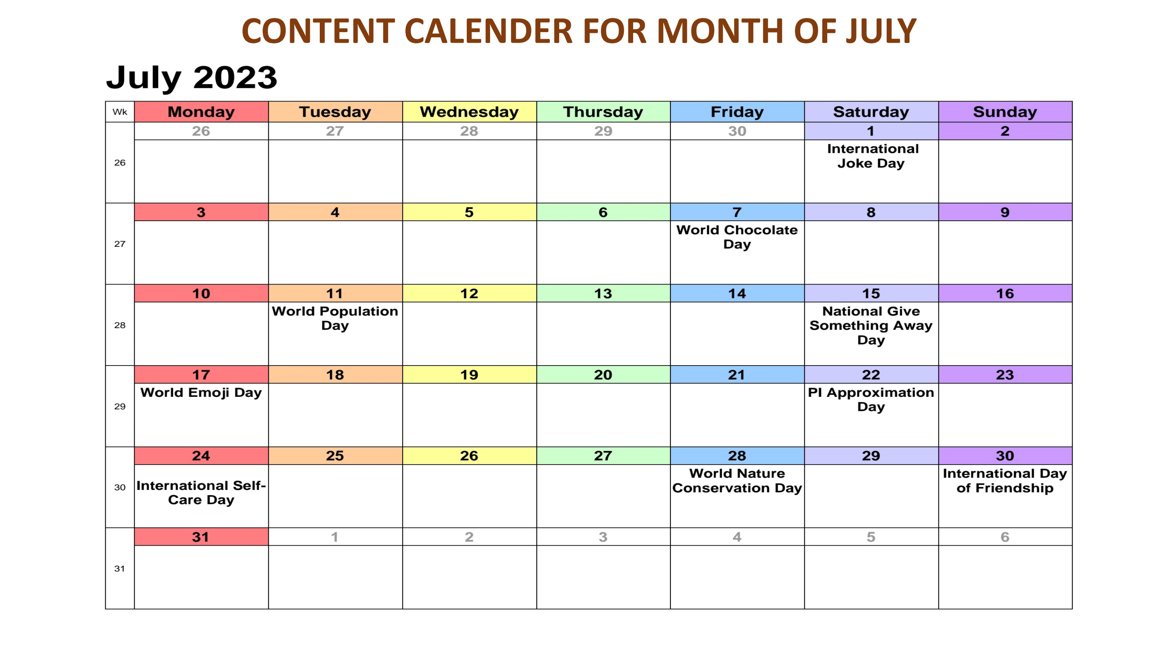
Content Calendar Example

Slide 24
Part 3: Content Ideas and Marketing Strategies
Content Calendar for July (Balaji Telefilms)
Content Theme: Celebrating Monsoon Magic
Week 4: July 24 - July 31
Content Formats:
Blog Posts: Detailed articles about monsoon-inspired stories, memorable rain scenes from Balaji Telefilms' shows, and the impact of monsoon on Indian television.
Videos: Behind-the-scenes footage of iconic rain sequences from Balaji Telefilms' popular series, or a montage of monsoon moments from different shows.
Infographics: Interesting facts and statistics related to monsoon, along with some trivia about Balaji Telefilms' monsoon-themed episodes.
Podcasts: Engaging discussions with actors, directors, and writers from Balaji Telefilms' shows, sharing their experiences and challenges while filming during the rainy season.Interactive Quizzes: Fun quizzes for fans to test their knowledge about monsoon-themed episodes in Balaji Telefilms' series.

Slide 25
Content Calendar:
July 24 - Blog Post: "Monsoon Memories: The Most Memorable Rain Scenes from Balaji Telefilms' Shows" Platform: Facebook & Instagram
July 25 - Video: "Behind-the-Scenes: Creating Monsoon Magic on Balaji Telefilms' Sets" Platform: Facebook & Instagram
July 26 - Infographic: "Monsoon Facts & Trivia: Did You Know?" Platform: Instagram
July 27 - Podcast: "Rainy Days on Set: Tales from Balaji Telefilms' Actors" Platform: Facebook
July 28 - Interactive Quiz: "How Well Do You Remember Balaji Telefilms' Monsoon Episodes?" Platform: Instagram
July 29 - Blog Post: "Monsoon Romance on Screen: The Evolution of Rainy Love Stories in Indian TV" Platform: Facebook & Instagram
July 30 - Video: "Top 5 Monsoon Moments from Balaji Telefilms' Shows" Platform: Facebook & Instagram
July 31 - Infographic: "Monsoon Special: Popular Balaji Telefilms Series to Binge-watch This Rainy Season" Platform: Instagram

Slide 26
In July 2023, Balaji Telefilms can leverage various social media holidays to engage their audience and create relevant and timely content. Here are some social media holidays for July 2023 that they can consider incorporating into their content strategy:
July 1 - International Joke Day: Share light-hearted and funny content related to Balaji Telefilms' shows or characters. Consider creating humorous memes or short video clips.
July 7 - World Chocolate Day: Connect chocolate with your shows by creating content that features characters enjoying chocolate treats or sharing sweet moments.
July 11 - World Population Day: Raise awareness about relevant social issues through thought-provoking content or sharing how Balaji Telefilms' shows address important topics.
July 15 - National Give Something Away Day: Host a giveaway or contest for fans to win Balaji Telefilms' show merchandise, DVDs, or exclusive access to content.
July 17 - World Emoji Day: Encourage fans to express their favorite Balaji Telefilms' show moments using emojis. Create emoji-themed quizzes or polls.
July 20 - Space Exploration Day: If any of Balaji Telefilms' shows have space-related storylines or episodes, highlight them on this day.

Slide 27
July 22 - Pi Approximation Day: Share intriguing math-related facts or puzzles that connect with Balaji Telefilms' shows.
July 24 - International Self-Care Day: Promote self-care tips and mental well-being, perhaps by featuring moments of self-care from characters in the shows.
July 28 - World Nature Conservation Day: Highlight eco-friendly initiatives, green practices, or episodes from Balaji Telefilms' shows that promote environmental conservation.
July 30 - International Day of Friendship: Celebrate the friendships portrayed in Balaji Telefilms' series and encourage fans to share their own friendship stories.
Remember to use relevant hashtags for each social media holiday to increase visibility and engagement. Additionally, ensure that the content aligns with Balaji Telefilms' brand identity and resonates with the interests of their target audience.

Slide 28
Part 3: Content Ideas and Marketing Strategies
Reflect on the content ideas and marketing strategies process, discussing the challenges encountered and lessons learned.
Challenges:
Content Creativity: Coming up with fresh and engaging content ideas consistently can be challenging, especially when promoting a specific genre or type of content, such as TV shows produced by Balaji Telefilms. It's important to strike a balance between promotional content and content that entertains and provides value to the audience.
Audience Engagement: Building and maintaining audience engagement is an ongoing challenge. Encouraging interactions, responding to comments, and fostering a sense of community can be time-consuming, but it is crucial for building brand loyalty.
Content Variety: Balaji Telefilms might face challenges in creating diverse content formats, such as videos, infographics, podcasts, and interactive quizzes. Each format requires different resources and expertise.
Social Media Algorithm Changes: Social media platforms often update their algorithms, which can impact the visibility and reach of Balaji Telefilms' content. Staying updated with these changes and adapting content strategies accordingly is essential.
Competition: The entertainment industry is highly competitive. Balaji Telefilms needs to find innovative ways to stand out from other production companies and keep their audience engaged

Slide 29
2. Lessons Learned:
Audience Research: Understanding the preferences, interests, and demographics of the target audience is vital. Conducting regular audience research and analyzing engagement metrics can provide valuable insights to tailor content accordingly.
Consistent Content Calendar: Creating a content calendar in advance helps maintain a consistent posting schedule and ensures a good mix of content types. Planning content around relevant social media holidays and trending topics can also boost engagement.
Leveraging User-Generated Content: Encouraging fans to create and share their content related to Balaji Telefilms' shows can be a powerful way to increase engagement and authenticity.
Collaboration and Partnerships: Collaborating with influencers or other brands can expand the reach of Balaji Telefilms' content and attract new audiences.
Storytelling: Balaji Telefilms can leverage the power of storytelling to create emotional connections with the audience. Sharing behind-the-scenes stories or anecdotes from the production process can humanize the brand.
Data-Driven Decisions: Rely on data and analytics to measure the performance of content and marketing efforts. Analyzing metrics can help identify what works best and inform future strategies.

Slide 30
Part 4: Content Creation and Curation (Post creations, Designs/Video Editing, Ad Campaigns over Social Media and Email Ideation and Creation)
Post Creation: Select Content Categories: Identify three different content formats relevant to the chosen topic or industry. Research and Brainstorm: Research trending topics, industry news, or audience
interests within each category. Brainstorm ideas for social media posts that align with each
category. Do note that 1 content format has to be video and additionally 3 stories/status are to
be created.
Content Formats:
Video: Behind-the-scenes (BTS) footage of TV shows or films being produced by Balaji Telefilms, showcasing the efforts and hard work that go into creating their popular content.
Infographics: Engaging and visually appealing infographics about the journey and achievements of Balaji Telefilms, highlighting key milestones and successful projects.
Fan Appreciation: Content that showcases the love and support of Balaji Telefilms' fans, such as fan art, testimonials, or creative videos expressing their favorite shows or characters.

Slide 31
Video - Behind-the-Scenes (BTS) Footage:
Trending Topic: "Get an exclusive look into the making of our latest TV show '_____'! Witness the dedication of our talented cast and crew as they bring this captivating story to life. #BTS #BehindTheScenes #TVProduction“
Industry News: "Balaji Telefilms announces a new collaboration with a top Bollywood star for their upcoming film. Stay tuned for behind-the-scenes sneak peeks and exciting updates! #Bollywood #FilmProduction #NewProject“
Audience Interests: "Ever wondered how your favorite characters come to life on the screen? Watch the magic unfold in this exclusive BTS video of our hit TV series '______'. #TVShows #FavCharacters #BalajiMagic"

Slide 32
2. Infographics - Balaji Telefilms Milestones:
Trending Topic: "Celebrating 25 years of entertainment excellence with Balaji Telefilms! Join us as we take a trip down memory lane and revisit our most iconic shows and movies. #25YearsOfBalaji #EntertainmentJourney #TVandFilm“
Industry News: "We are honored to receive multiple awards for '_____' at the prestigious _____ Film Festival. Thank you for recognizing our efforts in delivering exceptional content to our viewers. #AwardWinningContent #FilmFestival #BalajiTelefilms“
Audience Interests: "Did you know? Balaji Telefilms has been the driving force behind some of the most iconic TV shows in India. Check out this infographic to see the top 10 highest-rated shows produced by us! #TopTVShows #Blockbusters #BalajiProductions"

Slide 33
3. Fan Appreciation - Show-Specific Stories/Status: (Note: Stories/Status are short-lived posts on social media platforms, like Instagram and Facebook Stories.)
Story/Status 1: "To all the amazing fans who make our shows a huge success, this one's for you! Your love and support inspire us every day to create engaging and entertaining content. ❤️ #FanLove #Grateful #BalajiTelefilms"
Story/Status 2: "Calling all artists and creators! Show your love for Balaji Telefilms by sharing your fan art inspired by our shows. Tag us and use #BalajiFanArt, and we'll feature the best ones on our page! 🎨 #FanArtFriday #ShowYourTalent"
Story/Status 3: "Which Balaji Telefilms character has had the most impact on your life? Let us know in the comments below, and you might just get a special surprise from us! 😉 #FavoriteCharacter #MemorableMoments #BalajiMagic"

Slide 34
Post Creation:
Format 1: Video - Behind-the-Scenes (BTS) FootageFormat 1: Video - Behind-the-Scenes (BTS) Footage.
Trending Topic: "Get an exclusive sneak peek into the making of our upcoming blockbuster film! 🎥🎬 Witness the passion and dedication of our talented team as they bring this epic story to life. Stay tuned for more exciting updates! #BehindTheScenes #BTS #FilmMaking #BalajiMagic"
Industry News: "📢 Big Announcement! Balaji Telefilms collaborates with top industry stars for an exciting new web series. We can't wait to share this unique and gripping story with you all. #WebSeries #NewProject #BalajiCollaboration"
Audience Interests: "Your favorite stars, real emotions, and captivating storytelling - that's what makes our TV shows stand out! 🌟 Check out this exclusive BTS video of our latest TV show '_____' and immerse yourself in the world of entertainment. #TVShows #BalajiTelefilms #Entertainment"

Slide 35
Format 2: Infographics - Balaji Telefilms Milestones
Trending Topic: "🎉 Celebrating 30 years of entertaining India! 🎊 Join us on this nostalgic journey as we reminisce about our iconic TV shows and films that touched millions of hearts. Thank you for being part of this incredible ride. #30YearsOfBalaji #EntertainmentJourney #IconicShows"
Industry News: "We are humbled and grateful for the recognition of our hard work. Balaji Telefilms receives multiple awards at the prestigious _____ Awards ceremony. 🏆 Thank you to our amazing team and audiences for making this possible! #AwardWinningContent #BalajiPride #FilmAndTVAwards"
Audience Interests: "💡 Did You Know? Balaji Telefilms is known for breaking stereotypes and pushing boundaries with its unique storytelling. Check out this infographic showcasing our commitment to diverse and inclusive content. #InclusiveStorytelling #BreakingStereotypes #BalajiTelefilms"

Slide 36
Format 3: Fan Appreciation - Show-Specific Stories/Status
(Note: Stories/Status are short-lived posts on social media platforms, like Instagram and Facebook Stories.)
Story/Status 1: "🌟 To all our incredible fans - your love is our biggest motivation! ❤️ Share your favorite moments from our TV shows and films in the comments below, and let's celebrate the magic of entertainment together. #FanLove #BalajiFandom #MemorableMoments“
Story/Status 2: "🎨 Calling all artists and creators! We know our shows inspire amazing fan art. Tag us and use #BalajiFanArt to showcase your creativity, and we'll feature the best ones on our page. 🖌️🎭 #FanArtFriday #ShowYourTalent #BalajiInspiration“
Story/Status 3: "🤩 It's time to relive those unforgettable scenes and dialogues that made you laugh, cry, and cheer! Comment with your favorite Balaji Telefilms show or movie and tell us why it holds a special place in your heart. #FavoriteShow #MemorableScenes #BalajiMagic"

Slide 37
Part 4: Content Creation and Curation (Post creations, Designs/Video Editing, Ad Campaigns over Social Media and Email Ideation and Creation)
Instagram Story
Day 1: Behind-the-Scenes Glimpses 🎬
Story 1: "Lights, Camera, Action! 🎥 Step into the magical world of Balaji Telefilms as we bring you exclusive behind-the-scenes glimpses of our latest TV show in production. Swipe up to see the hardworking crew in action! #BehindTheScenes #TVShow #BalajiMagic"
Story 2: "Meet the Stars 🌟 Get ready to meet the talented cast of our upcoming film! Take a sneak peek at their on-set shenanigans and camaraderie. Don't forget to tap on the poll to guess who's the biggest prankster on the set! 😉 #FilmProduction #BehindTheScenes #OnSetFun"
Story 3: "Secrets Revealed! 🤫 We can't keep it to ourselves any longer. Here's a sneak peek at a crucial plot twist from our ongoing web series. Swipe left to see if you can predict what's coming next! #WebSeries #SneakPeek #PlotTwist"

Slide 38
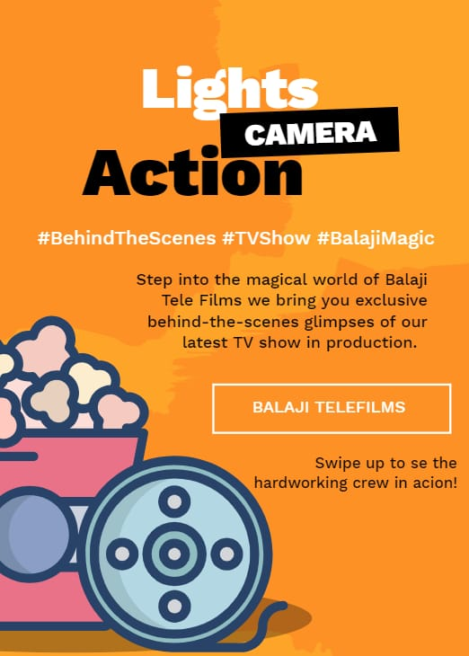


Highlight 1: "Behind the Scenes" 🎬

Slide 39
Day 2: Audience Participation 🗳️
Story 1: "Which Character Are You? 🎭 Take this fun quiz to find out which iconic character from our TV shows best represents your personality. Tag your friends and challenge them to take the quiz too! #QuizTime #TVCharacters #BalajiTelefilms“
Story 2: "This or That? 🤔 It's time for some tough decisions! Swipe up and vote for your preferred choice - be it your favorite on-screen couple, the best catchphrase, or the most memorable scene. Let your voice be heard! #ThisOrThat #AudienceOpinion #BalajiPoll“
Story 3: "Caption This! 📝 We're handing over the creative reins to you. Caption this hilarious behind-the-scenes photo from our latest film shoot. Comment your wittiest captions, and we'll feature the best ones in our next story! #CaptionContest #CreativeFans #BalajiCaptionThis"

Slide 40



Highlight 2: "Audience Engagements" 🗳️

Slide 41
Day 3: Sneak Peeks & Teasers 🎉
Story 1: "Epic Fight Scene Alert! 💥 Hold your breath as we give you a sneak peek at the action-packed climax from our upcoming blockbuster film. Tap on the heart if you're as excited as we are! #SneakPeek #ActionScene #UpcomingFilm“
Story 2: "Romance is in the Air ❤️ Get ready to fall in love with the mesmerizing chemistry between the lead pair of our new TV show. Swipe left for a heartwarming glimpse of their first meet-cute moment! #TVRomance #LeadPair #BalajiTelefilms“
Story 3: "Breaking News! 📢 Brace yourselves for the trailer of our much-awaited web series dropping tomorrow at 7 PM! Set a reminder and be the first to catch this thrilling rollercoaster ride. #WebSeriesTrailer #ThrillerAlert #BalajiTelefilms"

Slide 42



Highlight 3: "Sneak Peeks & Teasers" 🎉
By saving these stories as highlights, Balaji Telefilms can create a lasting and easily accessible collection of engaging content for their audience to enjoy and revisit at any time. This approach fosters a sense of community and excitement around their productions, leading to increased follower engagement and brand loyalty.

Slide 43

Part 4: Content Creation and Curation (Post creations, Designs/Video Editing, Ad Campaigns over Social Media and Email Ideation and Creation)
Designs/Video Editing

Slide 44
Part 4: Content Creation and Curation (Post creations, Designs/Video Editing, Ad Campaigns over Social Media and Email Ideation and Creation)
Ad Campaigns over Social Media: 3 ad campaigns:
Ad Campaign 1: Brand Awareness - "Experience the Magic of Balaji Telefilms“
Advertising Goal: Increasing brand awareness and introducing Balaji Telefilms to a broader audience.
Audience Targeting:
Demographics: Men and women aged 18-45, residing in India and other countries with a significant Indian entertainment audience.
Interests: Fans of Indian TV shows, films, and web series; followers of Balaji Telefilms' social media pages; entertainment enthusiasts.
Behavior: Users who engage with entertainment-related content on social media platforms.
Ad Creation:
Visuals: An eye-catching video showcasing snippets from Balaji Telefilms' most iconic TV shows, films, and web series, highlighting emotional and thrilling moments.
Ad Copy: "Welcome to the World of Balaji Telefilms - Where Emotions Unfold! From compelling dramas to heartwarming romances, immerse yourself in our captivating stories. Follow us for more entertainment magic! #BalajiTelefilms #EntertainmentUnleashed"
Call-to-Action: "Follow" or "Like" the page to stay updated with new releases and behind-the-scenes content.

Slide 45
Campaign 2: Driving Website Traffic - "Exclusive Behind-the-Scenes on Our Website"
Advertising Goal: Driving website traffic and encouraging users to explore exclusive behind-the-scenes content on Balaji Telefilms' official website.
Audience Targeting:
Demographics: Men and women aged 18-45, primarily in India, and other regions with a strong interest in Indian entertainment.
Interests: Fans of Balaji Telefilms' TV shows, films, and web series; users who have engaged with similar content on social media.
Behavior: Users who show an interest in entertainment and regularly engage with content from the entertainment industry.
Ad Creation:
Visuals: A carousel ad featuring high-quality behind-the-scenes images and videos from recent TV shows, films, and web series produced by Balaji Telefilms.
Ad Copy: "Discover the Magic Behind-the-Scenes! Get an exclusive peek into the making of your favorite TV shows and films. Visit our official website for behind-the-scenes stories and more. #BalajiTelefilms #BehindTheScenes #EntertainmentUnveiled"
Call-to-Action: "Learn More" or "Visit Website" buttons leading to the behind-the-scenes content on the official website.

Slide 46
Campaign 3: Generating Leads - "Join the Balaji Telefilms Fan Club“
Advertising Goal: Generating leads by inviting the audience to join an exclusive fan club for Balaji Telefilms with special benefits.
Audience Targeting:
Demographics: Men and women aged 18-45, fans of Balaji Telefilms' content, primarily residing in India.
Interests: Engaged followers of Balaji Telefilms' social media pages, fans of specific TV shows and films produced by the company.
Behavior: Users who have shown interest in entertainment-related content and have engaged with Balaji Telefilms' posts.
Ad Creation:
Visuals: An enticing image featuring the fan club logo and a group of enthusiastic fans celebrating their love for Balaji Telefilms' content.
Ad Copy: "Join the Balaji Telefilms Fan Club! Experience entertainment like never before with exclusive access to behind-the-scenes, special previews, contests, and more. Be part of a passionate community. Sign up today! #BalajiFanClub #EntertainmentEnthusiasts"
Call-to-Action: "Sign Up" or "Join Now" leading to a lead generation form where users can provide their email addresses to become a member of the fan club.

Slide 47
Part 4: Content Creation and Curation (Post creations, Designs/Video Editing, Ad Campaigns over Social Media and Email Ideation and Creation)
Email Ad Campaigns :
balajiteleflimbrandawareness@gmail.com
generationbalajiteleflim@gmail.com

Slide 48
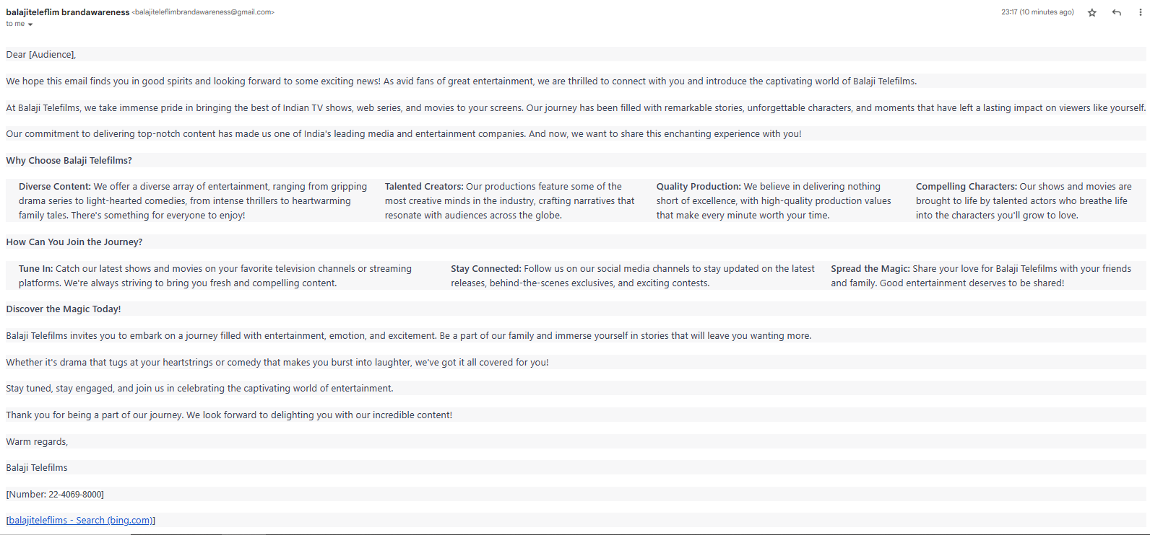
Email Ad Campaign 1 - Brand Awareness (insert emailer image) balajiteleflimbrandawareness@gmail.com

Slide 49
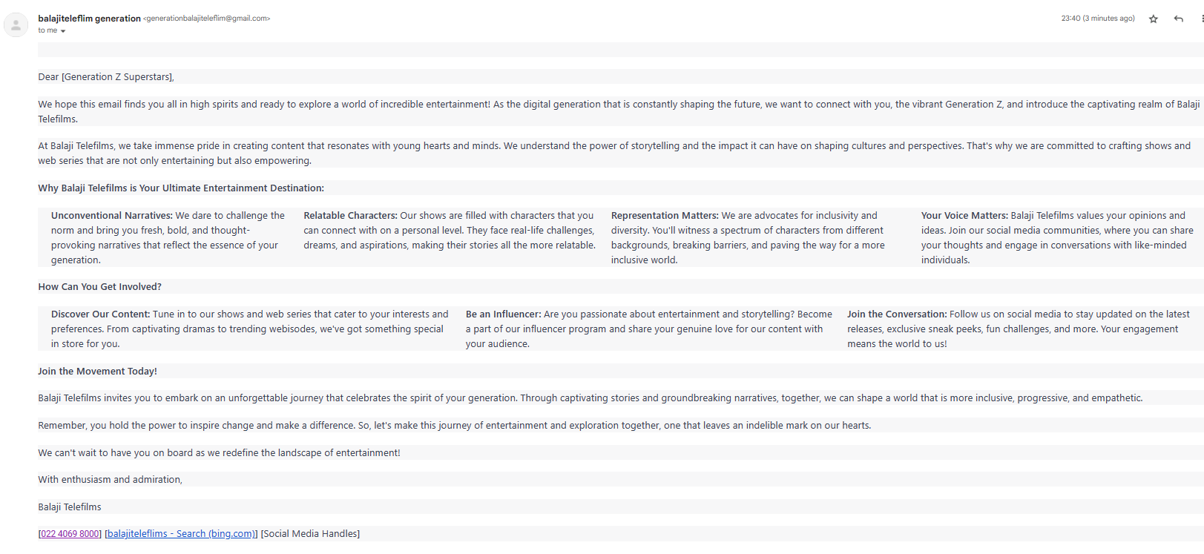
Email Ad Campaign 2 - Lead Generation (insert emailer image)
generationbalajiteleflim@gmail.com

Slide 50
Part 4: Content Creation and Curation (Post creations, Designs/Video Editing, Ad Campaigns over Social Media and Email Ideation and Creation)
Reflect on the content creation and curation process, discussing the challenges faced and lessons learned.
Content creation and curation for Balaji Telefilms can be both exciting and challenging. Here are some reflections on the process, along with the challenges faced and lessons learned:
Challenges Faced:
Maintaining Relevance: One of the primary challenges was consistently creating content that remained relevant to the diverse audience of Balaji Telefilms. Balancing content for different shows, genres, and demographics required careful planning and a deep understanding of the audience's preferences.
Content Diversity: Balaji Telefilms produces a wide range of content, including television shows, films, and digital series. Curating a diverse range of content that catered to the preferences of different viewer segments was a constant challenge.
Engagement vs. Promotion: Finding the right balance between engaging content and promotional content was a recurring challenge. While the goal was to engage and entertain, there was also a need to promote upcoming shows and projects without overwhelming the audience.

Slide 51
Lessons Learned:
Audience Insights: Understanding the audience's viewing habits, preferences, and trends was essential for crafting content that resonated. Analyzing viewership data and social media engagement helped tailor content to audience expectations.
Content Customization: Tailoring content to different platforms and formats allowed Balaji Telefilms to maximize engagement. Each platform has its unique dynamics, and adapting content accordingly ensured wider reach and impact.
Interactive Content: Incorporating interactive elements such as polls, quizzes, and Q&A sessions encouraged active participation from the audience. It transformed content consumption into a two-way conversation, enhancing engagement.
Behind-the-Scenes Glimpses: Sharing behind-the-scenes content, including set tours, cast interactions, and bloopers, provided a personal touch and humanized the brand. This approach strengthened the emotional connection with the audience.
Consistent Branding: Maintaining consistent branding elements such as colors, logos, and tone of voice helped reinforce Balaji Telefilms' identity across different content pieces. It contributed to brand recognition and recall.
Timely Relevance: Capitalizing on current events, festivals, and trends ensured that the content remained timely and relatable. This approach helped maintain the brand's relevance in a fast-paced digital landscape.
In conclusion, the content creation and curation process for Balaji Telefilms offered valuable insights into effectively engaging audiences, promoting entertainment content, and building a strong brand presence. While challenges like maintaining relevance and balancing engagement with promotion were present, the lessons learned emphasized the significance of audience understanding, content customization, and consistent branding in shaping a successful content strategy. This journey underscored the power of storytelling and interaction in fostering a deeper connection between the brand and its audience.

Slide 52


